Slide 1
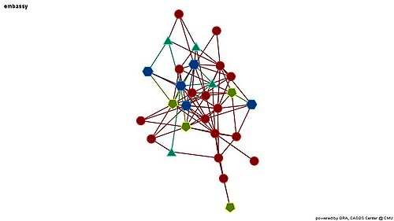
A Parallel Algorithm for Updating a Multi-objective Shortest Path in Large Dynamic Networks
Authors: Khanda, Shovan, Das
Presented by: Amman Haroon (22i-0768), Abdul Rafay (22i-0843), Abdul Samee (22i-1051)
Tech Stack: OpenMP (intra-node), MPI (inter-node), METIS (partitioning)
Overview: Fast updates for multi-objective shortest paths in massive, changing networks.

Slide 2
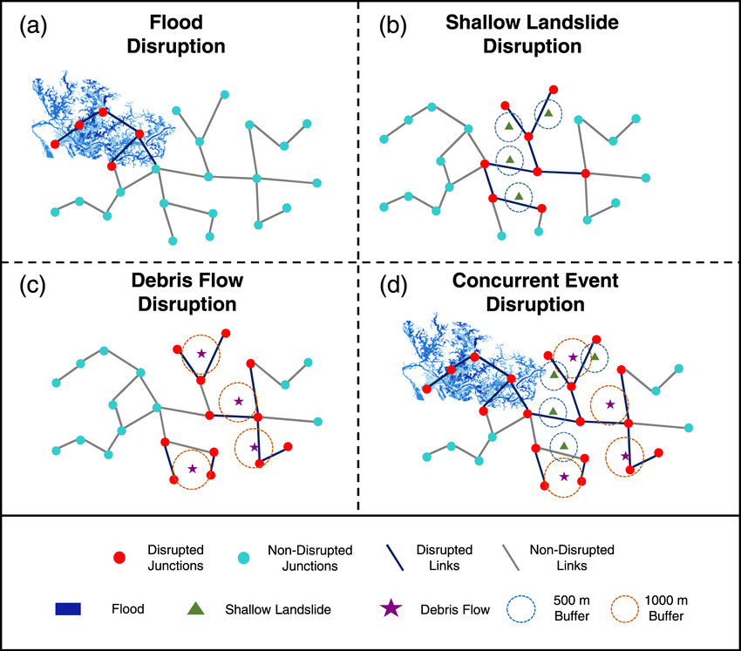
Problem & Motivation
• Real-world graphs are dynamic: edges/nodes frequently change.
• Multi-objective pathfinding (e.g., time vs. cost vs. distance) is hard.
• Recomputing everything from scratch is too slow.
• Challenge: Efficient updates without full recomputation.
• Need: A scalable, parallel method that reacts quickly to changes.

Slide 3
Proposed Algorithm
• SOSP Update Algorithm:
- Detects affected areas only
- Uses OpenMP for parallel updates
• MOSP Heuristic:
- Builds on SOSP
- Finds one good Pareto-optimal path fast
- Avoids computing full Pareto front
• Combines efficiency with parallel scalability.

Slide 4
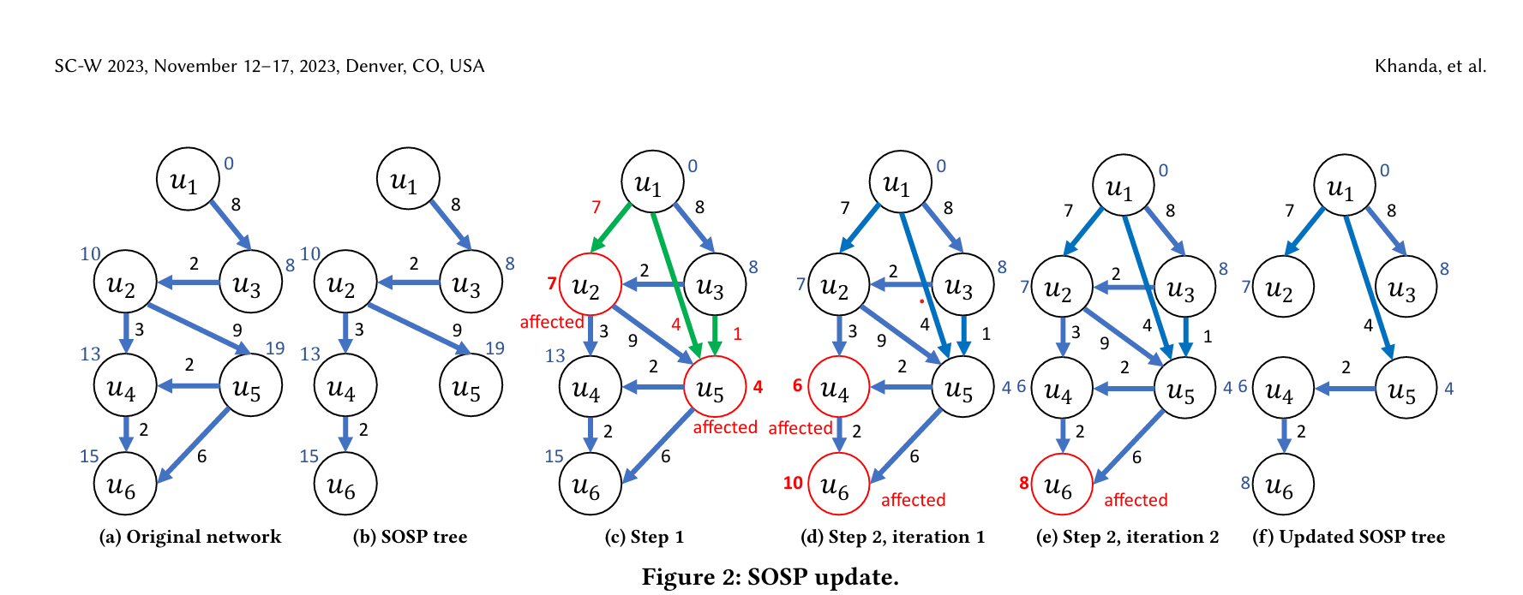

Slide 5
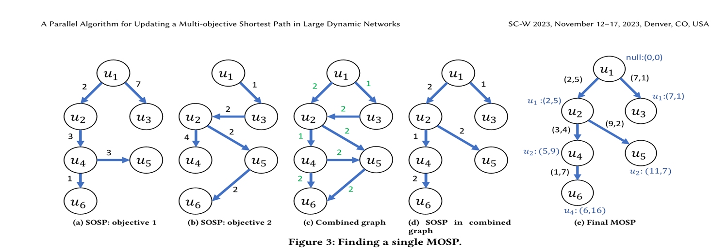

Slide 6
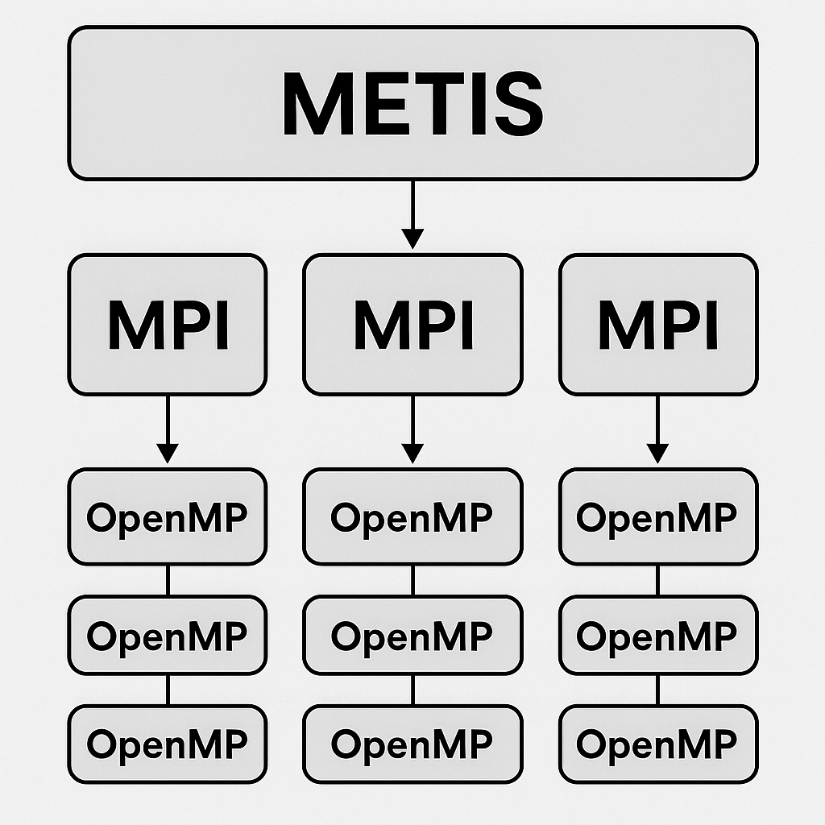
Parallelization Strategy
• METIS: Graph partitioning
- Keeps related nodes together
- Reduces cross-node communication
• MPI: Inter-node updates
- Each partition on a different machine
- Sync only needed subgraphs
• OpenMP: Intra-node updates
- Threads update independent nodes in parallel

Slide 7
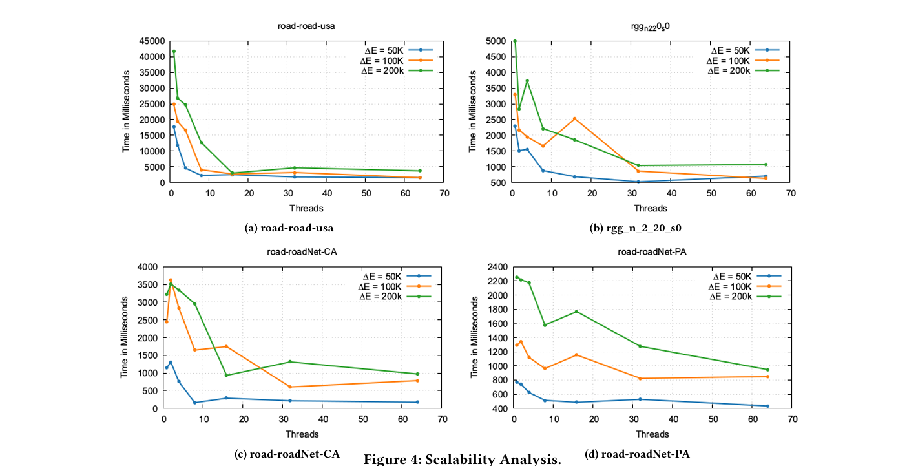
Results & Observations
• Tested on multiple large networks (real + synthetic)
• Metrics: Update time, speedup, scalability
• Speedup: Up to 4x on 8-core CPUs
• Scalability: Good performance with increasing core count

Slide 8
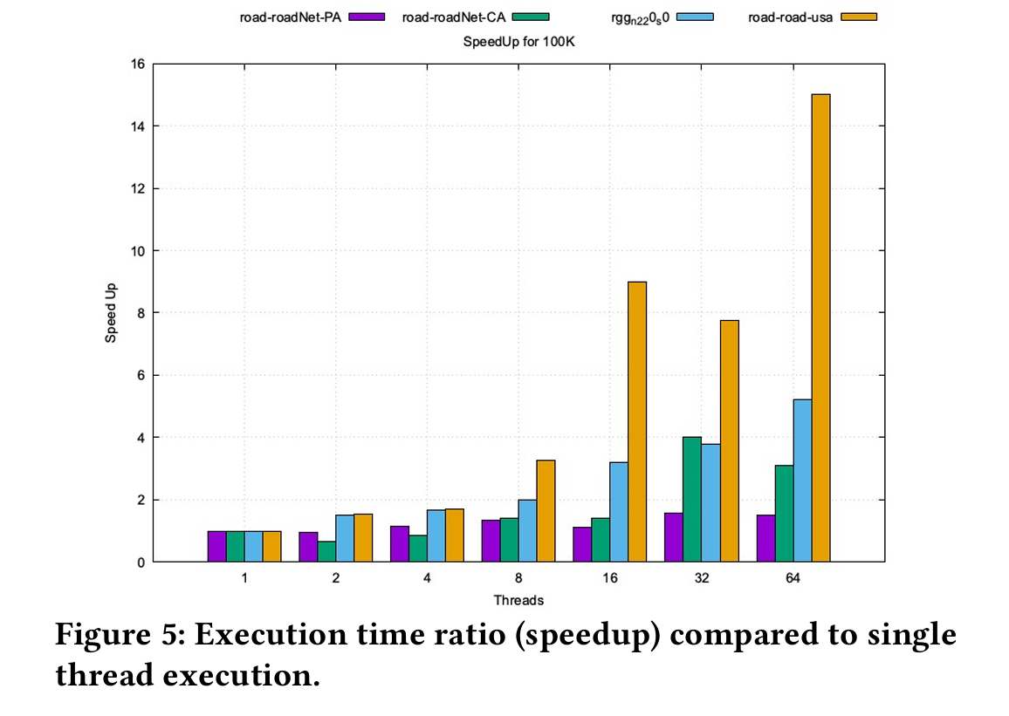

Slide 9
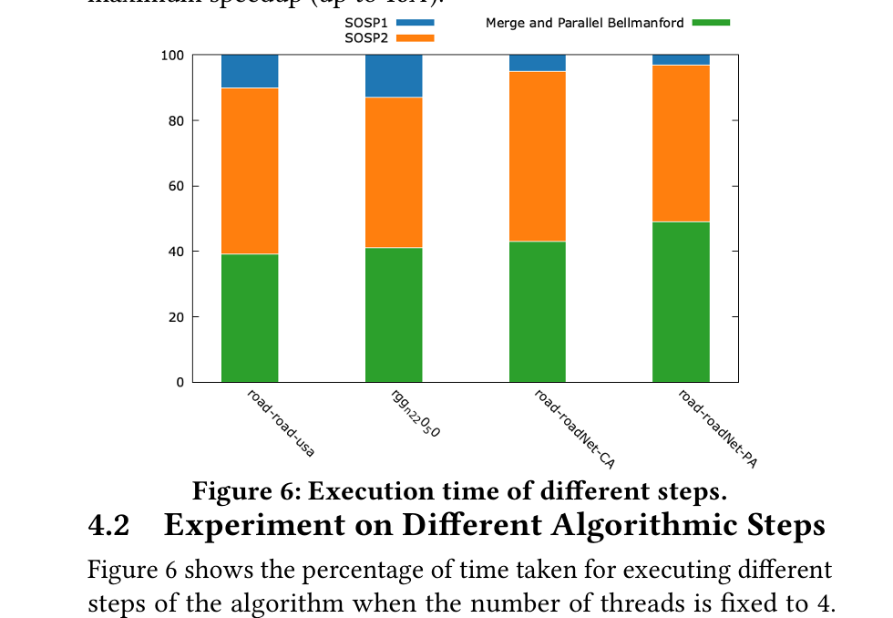

Slide 10


Key Contributions
• Novel parallel update for multi-objective paths
• Hybrid SOSP + Heuristic method
• Works on large, dynamic graphs
• Efficient intra-node and inter-node parallelism
• Adaptable to heterogeneous hardware

Slide 11

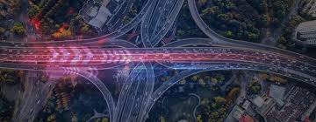
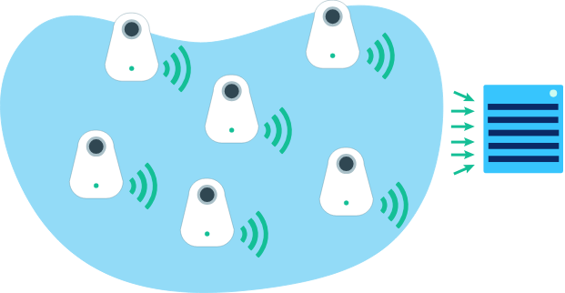
Applications and Future Scope
• Fast, scalable updates critical for dynamic systems
• Applications:
- Smart traffic routing
- Sensor networks
- Real-time logistics
• Future work:
- Full Pareto front exploration
- GPU acceleration
- Improved heuristics for better path quality

Slide 12
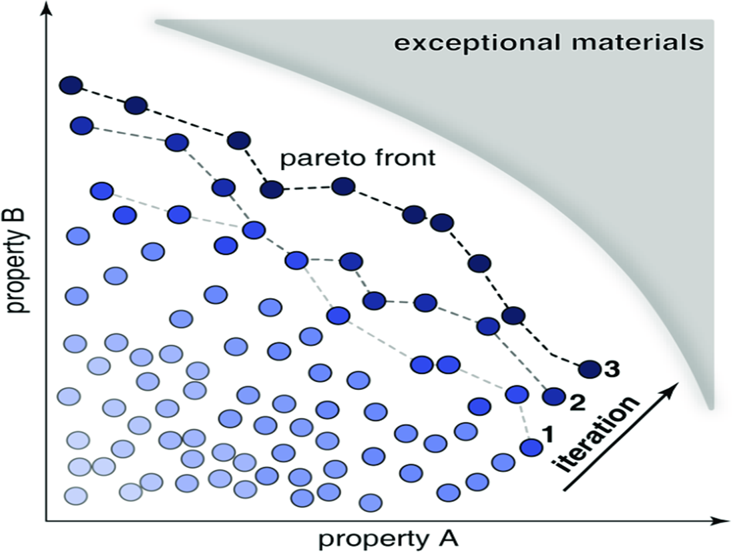
Conclusion… "Converging Toward Optimal Paths — One Iteration at a Time"

